Slide 1

Model representation
Linear regression with one variable
Machine Learning

Slide 2
Housing Prices
(Portland, OR)
Price
(in 1000s of dollars)
Size (feet²)
Supervised Learning
Given the “right answer” for each example in the data.
Regression Problem
Predict real-valued output

Slide 3
Training set of
housing prices
(Portland, OR)
Size in feet² (x) | Price ($) in 1000's (y)
2104 | 460
1416 | 232
1534 | 315
852 | 178
… | …
Notation:
m = Number of training examples
x’s = “input” variable / features
y’s = “output” variable / “target” variable

Slide 4
Training Set
How do we represent h ?
Learning Algorithm
Size of house
h
Estimated price
Linear regression with one variable.
Univariate linear regression.

Slide 5
Cost function
Linear regression with one variable
Machine Learning

Slide 6
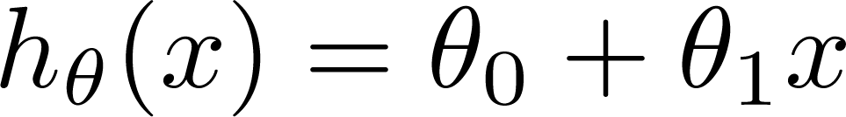

Training Set
Size in feet² (x) | Price ($) in 1000's (y)
2104 | 460
1416 | 232
1534 | 315
852 | 178
… | …
Hypothesis:
‘s: Parameters
How to choose ‘s ?

Slide 7
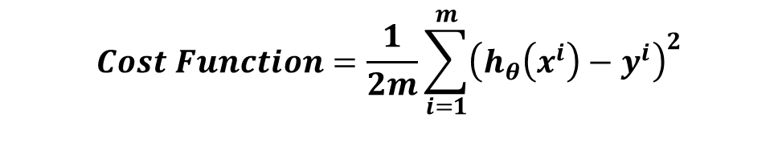
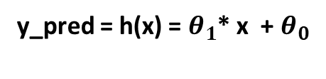
Target
y_pred = h(x) = $θ_{1}$* x + $θ_{0}$
Error = Sum over for all examples (y_pred - y)^2
y_pred
y
Error = y_pred - y
$$Cost Function=\frac{1}{2m}\sum_{i=1}^{m}{{\left(h_{θ}\left(x^{i}\right)−y^{i}\right)}^{2}}$$
x
Feature

Slide 8
Cost function intuition I
Linear regression with one variable
Machine Learning

Slide 9
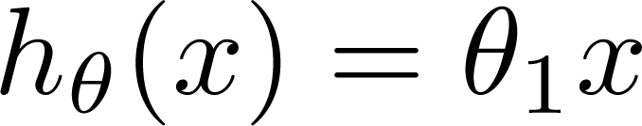
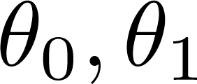

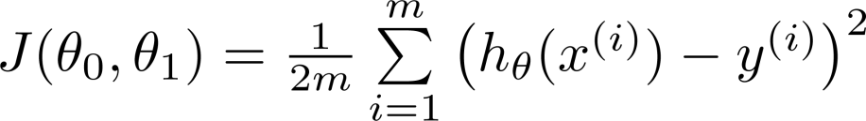
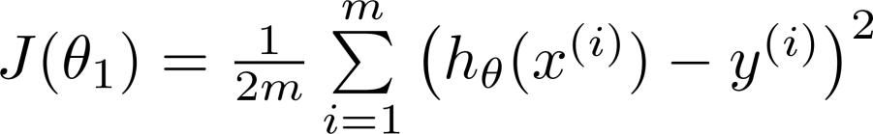
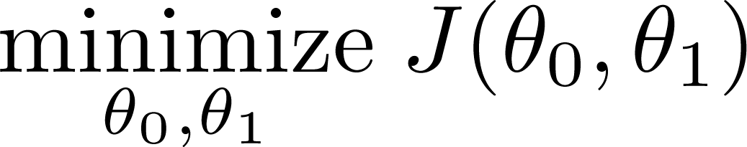
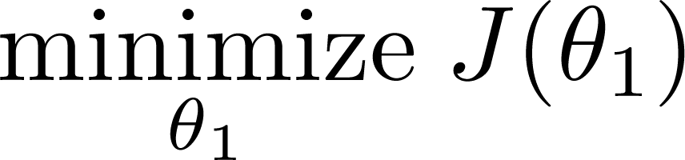
Simplified
Hypothesis:
Parameters:
Cost Function:
Goal:

Slide 10
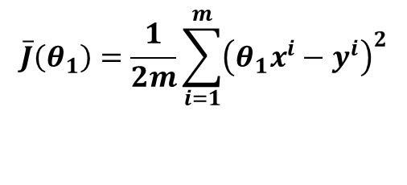

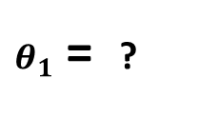

h(x)
h(x) = $θ_{1}$* x (Since $θ_{0}$ = 0 )
5
4
3
2
1
$θ_{1}$ = ?
y = x
$$\overline{J}\left(θ_{1}\right)=\frac{1}{2m}\sum_{i=1}^{m}{{\left(θ_{1}x^{i}−y^{i}\right)}^{2}}$$
Error or J($θ_{1}$)= 0
1 2 3 4 5
x

Slide 11






(for fixed , this is a function of x)
(function of the parameter )
y
x

Slide 12

(for fixed , this is a function of x)
(function of the parameter )
y
x

Slide 13

(for fixed , this is a function of x)
(function of the parameter )
y
x

Slide 14
Cost function intuition II
Linear regression with one variable
Machine Learning

Slide 15
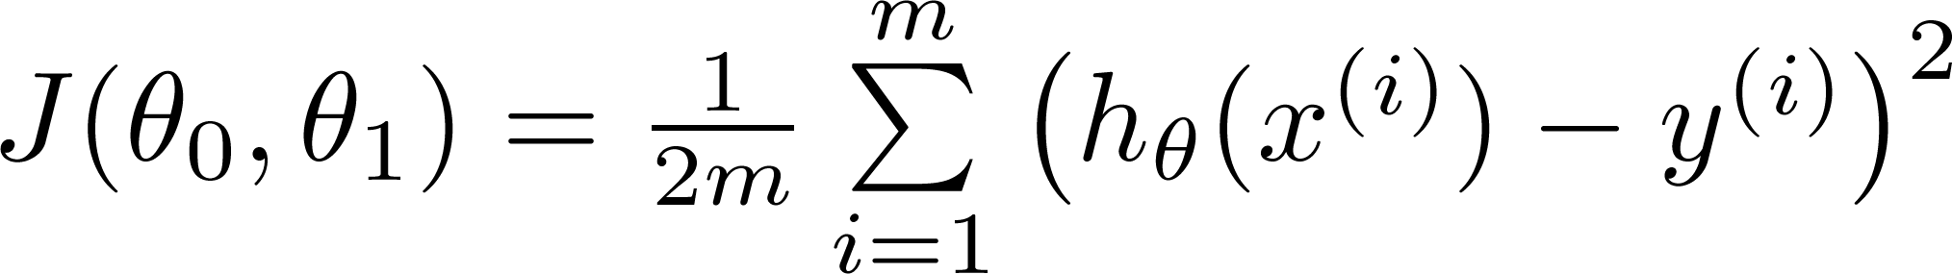
Hypothesis:
Parameters:
Cost Function:
Goal:

Slide 16
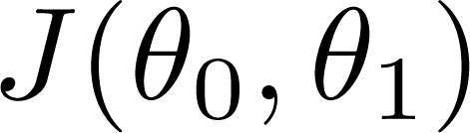


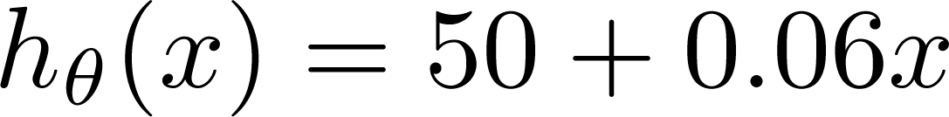
(for fixed , this is a function of x)
(function of the parameters )
Price ($)
in 1000’s
Size in feet² (x)

Slide 17
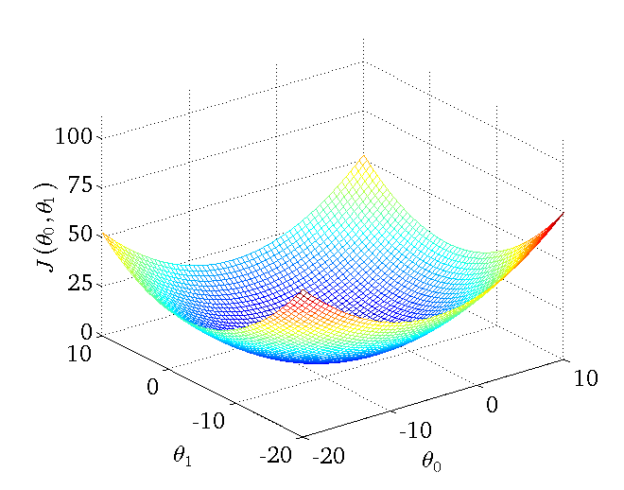

Slide 18
Gradient descent
Linear regression with one variable
Machine Learning

Slide 19
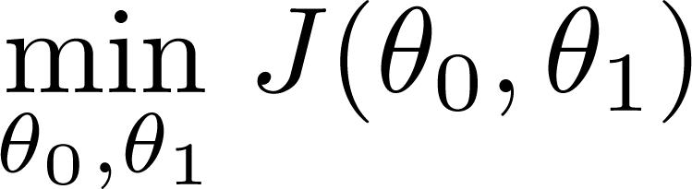
Have some function
Want
Outline:
Start with some
Keep changing to reduce until we hopefully end up at a minimum

Slide 20

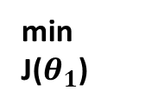




Goal : To reach at the minima
h(x) = $θ_{1}$* x (Since $θ_{0}$ = 0 )
J($θ_{1}$)
$$\overline{J}\left(θ_{1}\right)=\frac{1}{2m}\sum_{i=1}^{m}{{\left(θ_{1}x^{i}−y^{i}\right)}^{2}}$$
-ve slope
$$J\left(θ_{1}\right) α θ_{1}^{2}$$
$$θ_{1}=θ_{1}−α\frac{∂\overline{J}\left(θ_{1}\right)}{∂θ_{1}}$$
+ve slope
Where $α$ is learning rate or step-size
min
J($θ_{1}$)
$$\frac{∂J\left(θ_{1}\right)}{∂θ_{1}}=\frac{1}{m}\sum_{i=1}^{m}{\left(θ_{1}x^{i}−y^{i}\right)}.(x^{i})$$
$$θ_{1}= θ$$
$$θ_{1}$$

Slide 21






J($θ_{1}$)
1. Start with Random values of $θ_{1}$
2. Calculate the cost function
$$\overline{J}\left(θ_{1}\right)=\frac{1}{2m}\sum_{i=1}^{m}{{\left(θ_{1}x^{i}−y^{i}\right)}^{2}}$$
3. Calculate the Gradient at that point
$$\frac{∂J\left(θ_{1}\right)}{∂θ_{1}}=\frac{1}{m}\sum_{i=1}^{m}{\left(θ_{1}x^{i}−y^{i}\right)}.(x^{i})$$
4. Update the value of $θ_{1}$
$$θ_{1}=θ_{1}−α\frac{∂\overline{J}\left(θ_{1}\right)}{∂θ_{1}}$$
5. Repeat step 2-4 until you reach at minima
$$θ_{1}$$

Slide 22
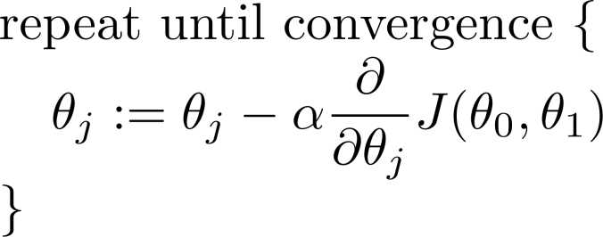
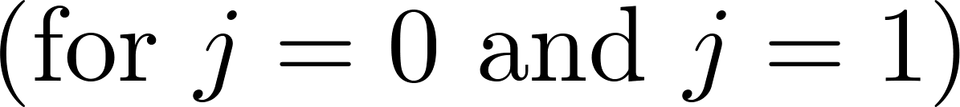
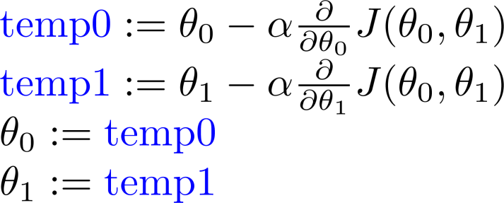
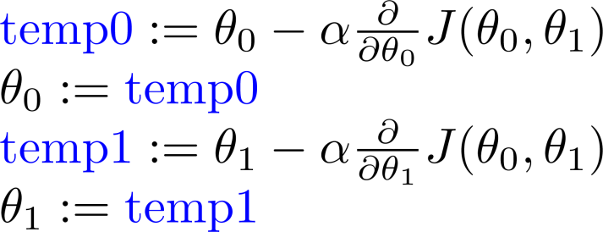
Gradient descent algorithm
Correct: Simultaneous update
Incorrect:

Slide 23
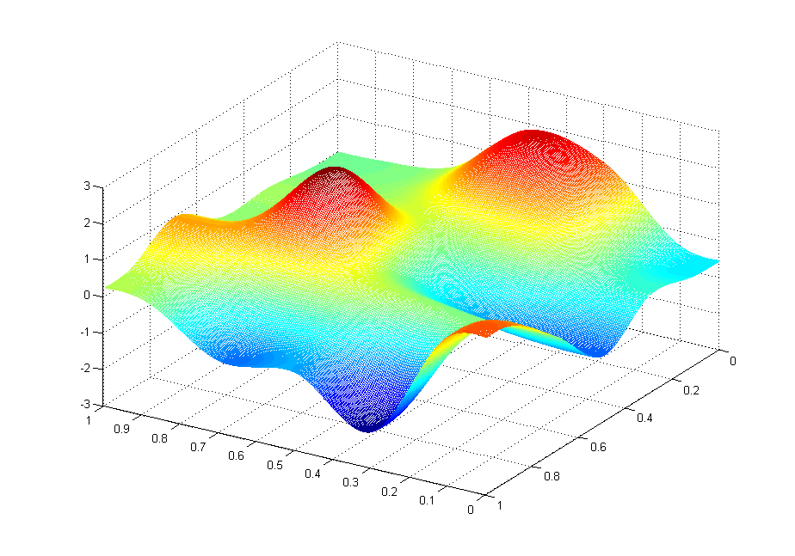
J(θ₀,θ₁)
θ₁
θ₀

Slide 24
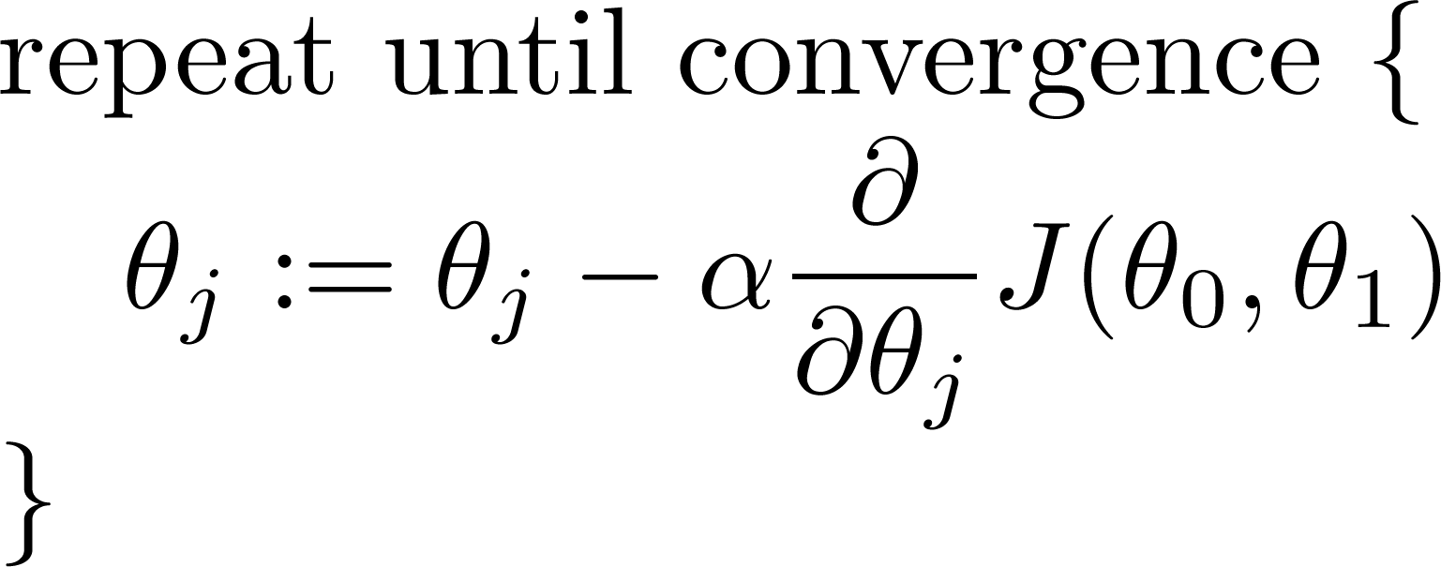
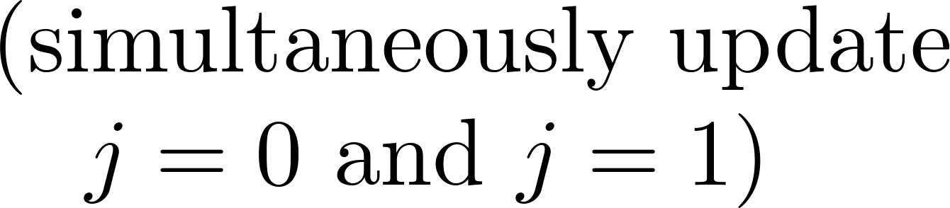
Gradient descent algorithm

Slide 25
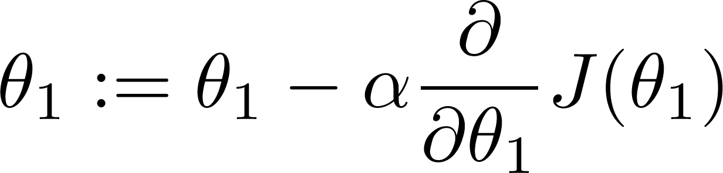
If α is too small, gradient descent can be slow.
If α is too large, gradient descent can overshoot the minimum. It may fail to converge, or even diverge.

Slide 26
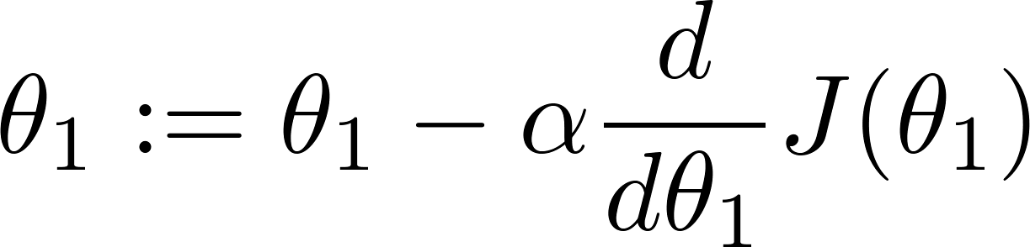
Gradient descent can converge to a local minimum, even with the learning rate α fixed.
As we approach a local minimum, gradient descent will automatically take smaller steps. So, no need to decrease α over time.

Slide 27
Gradient descent for linear regression
Linear regression with one variable
Machine Learning

Slide 28
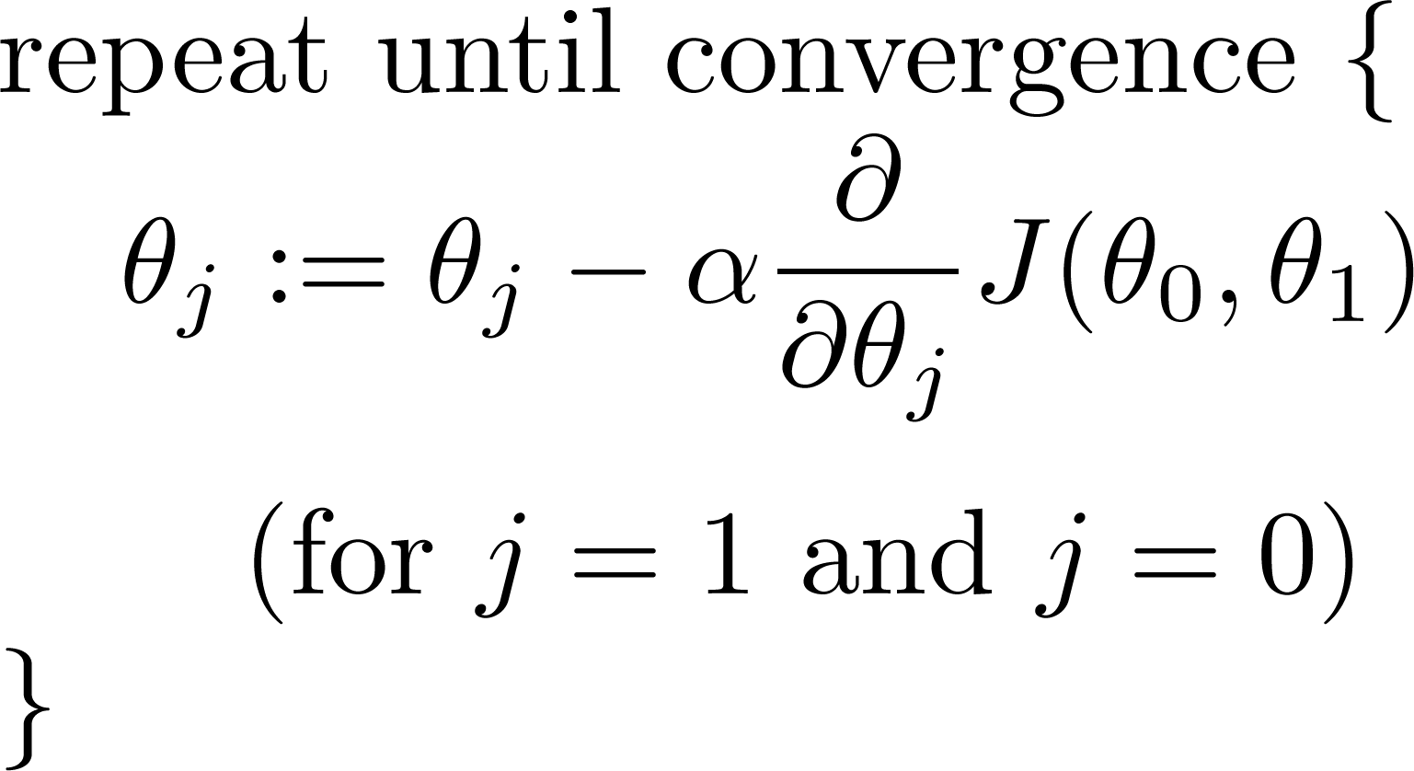
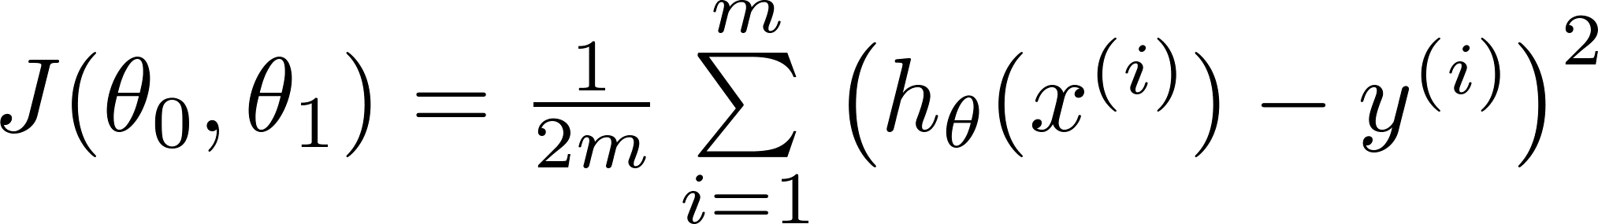
Gradient descent algorithm
Linear Regression Model

Slide 29
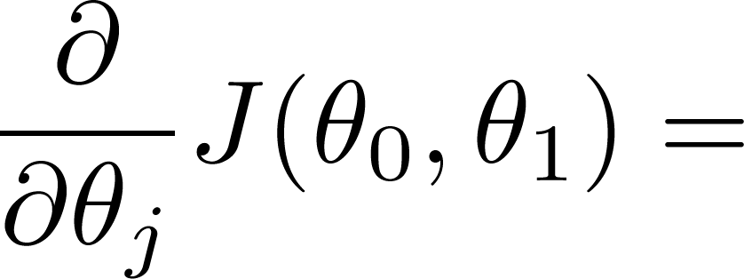
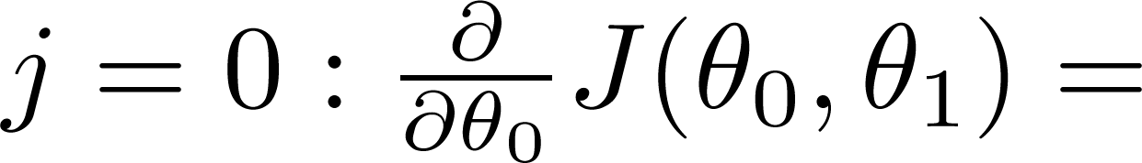
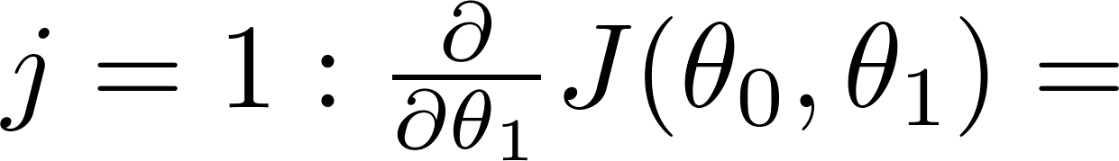

Slide 30
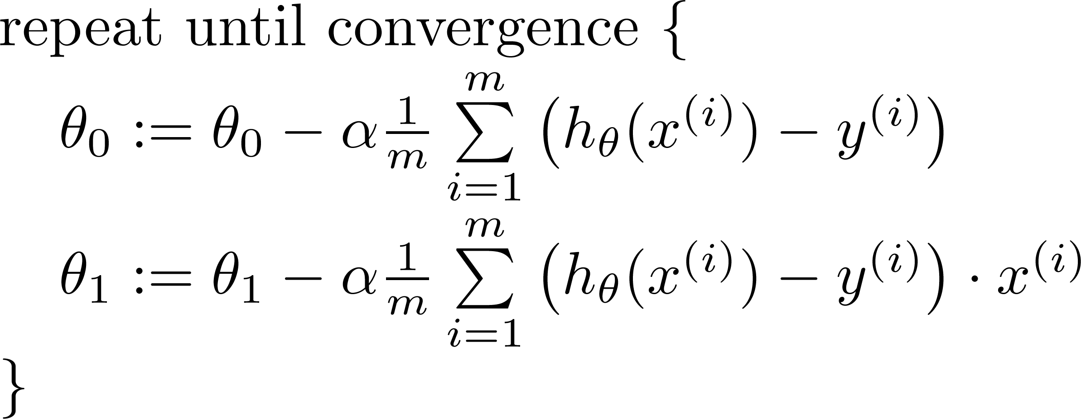

Gradient descent algorithm
update
and
simultaneously

Slide 31
J(θ₀,θ₁)
θ₁
θ₀

Slide 32
Linear Regression with multiple variables
Multiple features
Machine Learning

Slide 33
Multiple features (variables).
Size (feet²) | Number of bedrooms | Number of floors | Age of home (years) | Price ($1000)
2104 | 5 | 1 | 45 | 460
1416 | 3 | 2 | 40 | 232
1534 | 3 | 2 | 30 | 315
852 | 2 | 1 | 36 | 178
… | … | … | … | …

Slide 34

Hypothesis:
Previously:

Slide 35
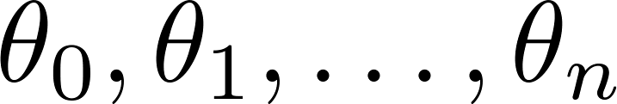
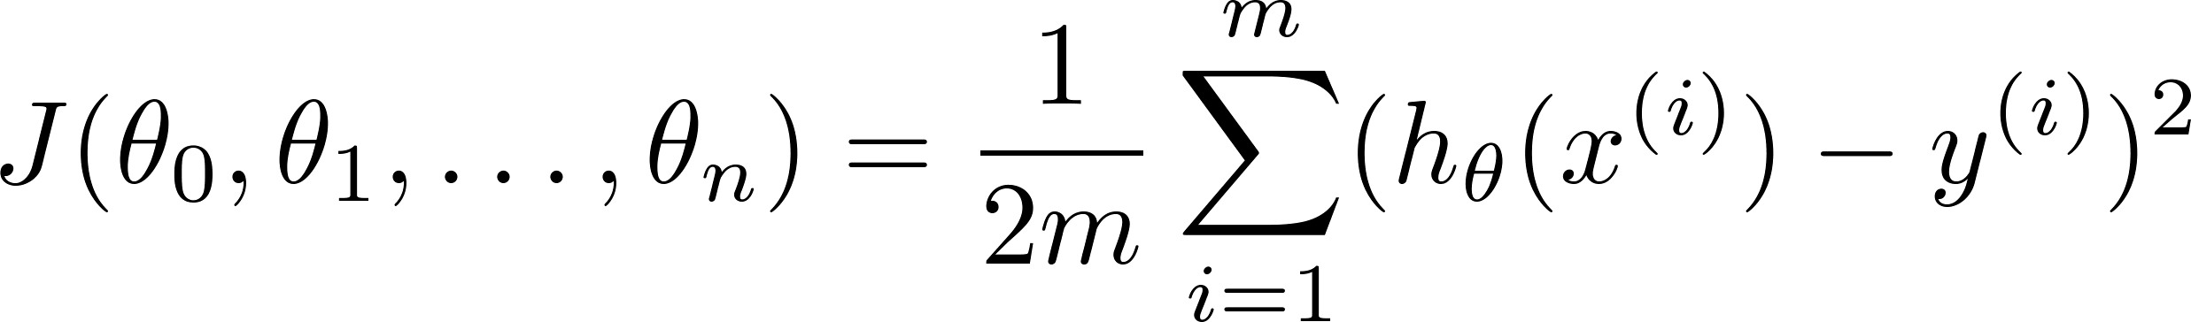

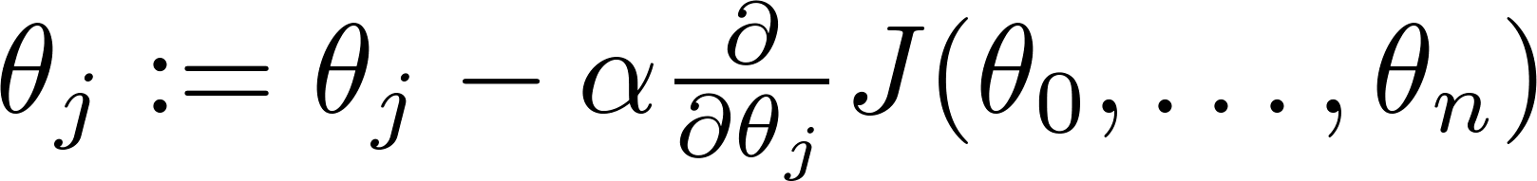

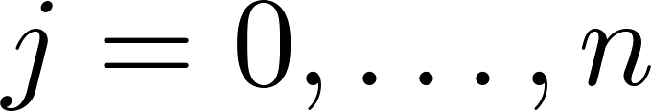


Hypothesis:
Parameters:
$$x=\left[\begin{matrix}1 \\ x_{1} \\ x_{2} \\ . \\ . \\ . \\ x_{n}\end{matrix}\right]$$
Cost function:
$$θ=\left[\begin{matrix}θ_{0} \\ θ_{1} \\ . \\ . \\ . \\ θ_{n}\end{matrix}\right]$$
Gradient descent:
Repeat
(simultaneously update for every )

Slide 36

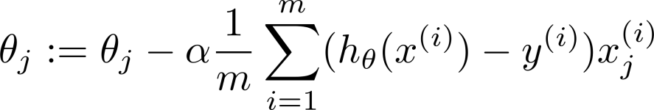
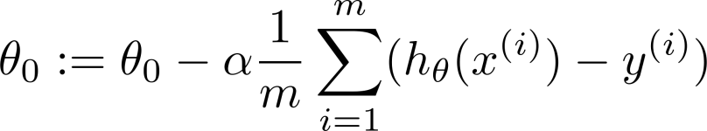



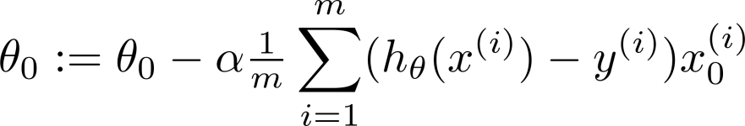
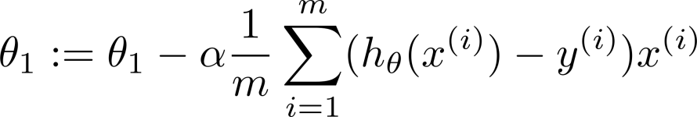
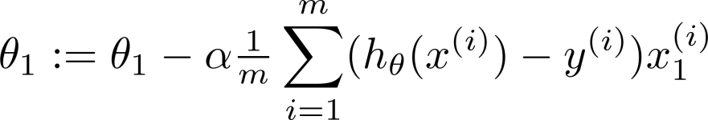

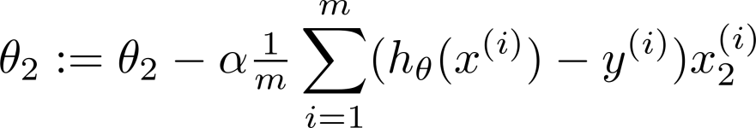
New algorithm :
Gradient Descent
Repeat
Previously (n=1):
Repeat
(simultaneously update for
)
(simultaneously update )

